Slide 1
Unused Slides

Slide 2
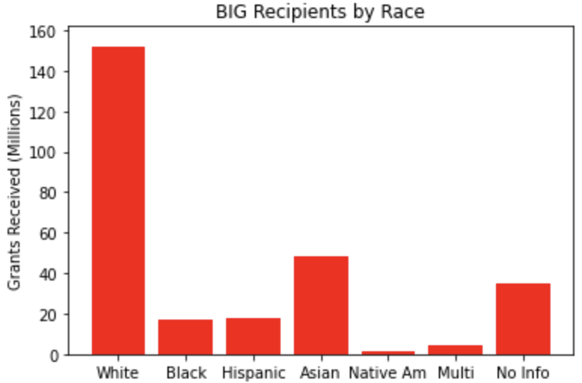
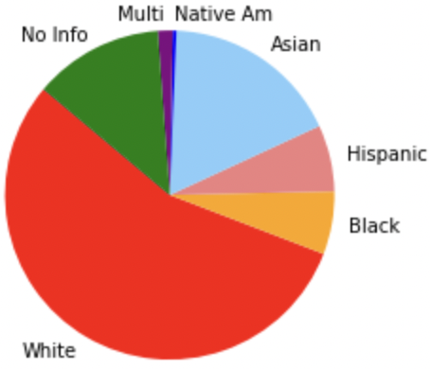
BIG Recipients by Ethnicity of Business Owner
Source: https://www2.illinois.gov/dceo/SmallBizAssistance/Documents/BIG%20Detailed%20Data%201.8.21.pdf
Notes:
Delete slide before submission, not relevant

